Slide 1
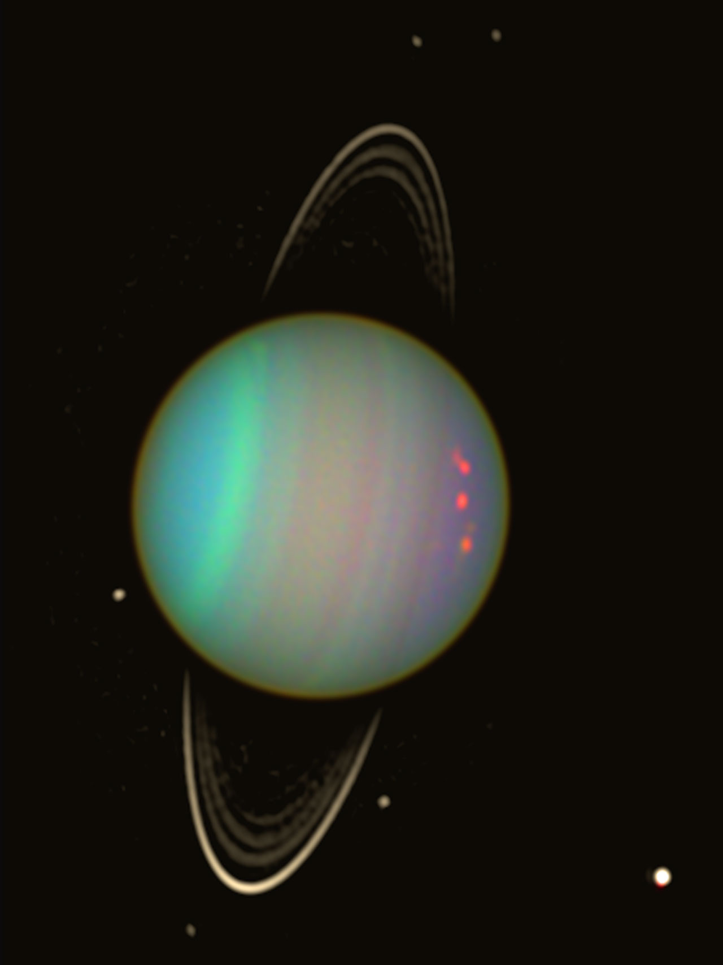
Uranus:
the sideways planet

Slide 2
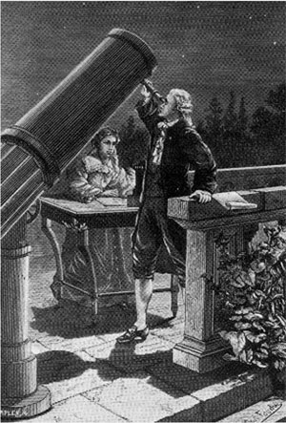
Uranus was discovered on March 13, 1781 by British astronomer William Herschel.
He wanted to name it the “Georgian Star” after King George III, his patron.

Slide 3
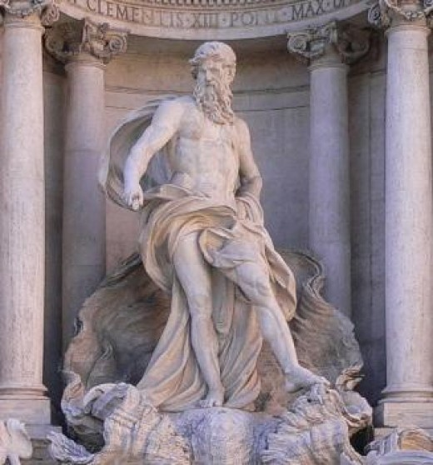
Uranus was the Greek god of sky and the father of Saturn
(although Uranus is a Greek name and Saturn is Roman name).

Slide 4
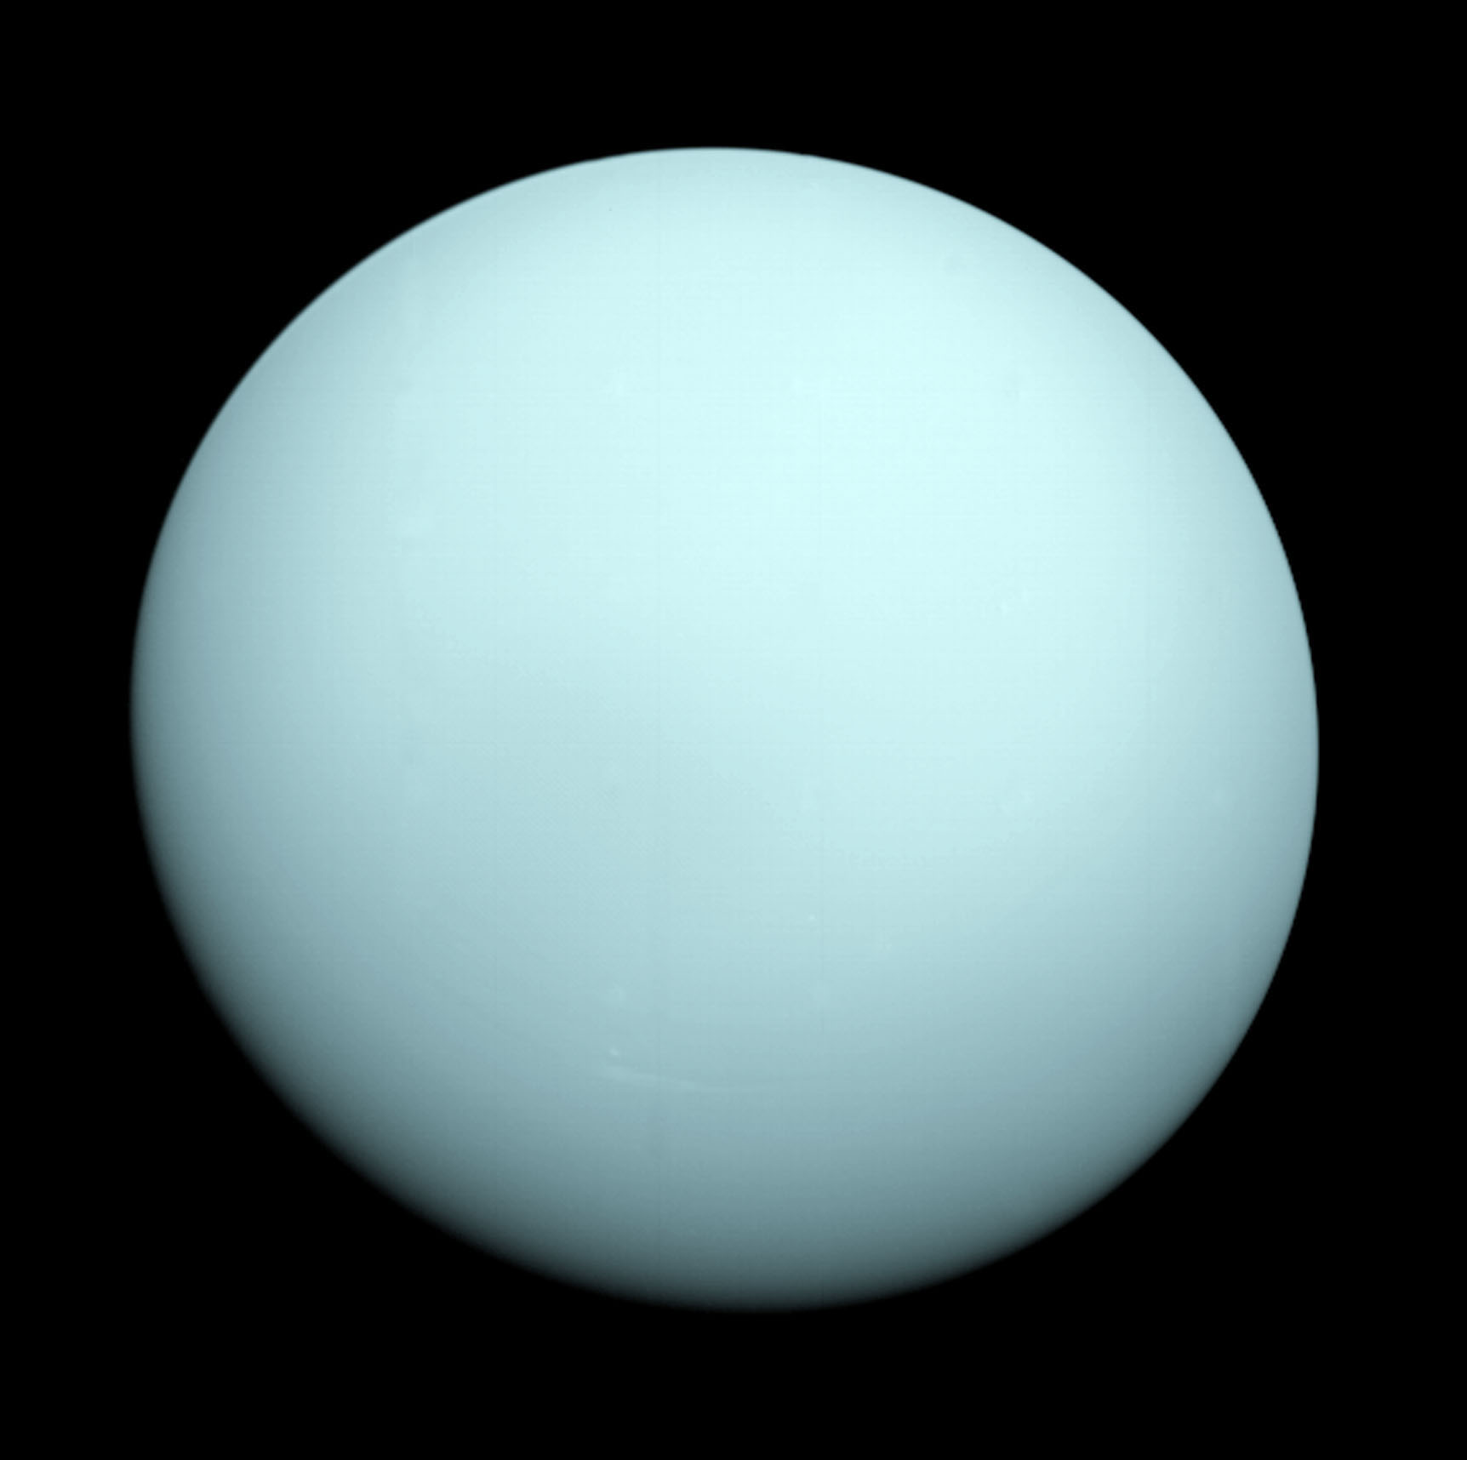
Uranus was the first planet discovered since prehistoric times.

Slide 5
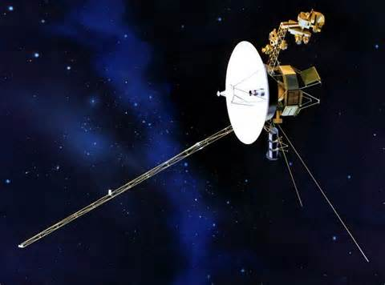
In 1986, Voyager 2 flew past Uranus. It is the only time we have visited it.

Slide 6
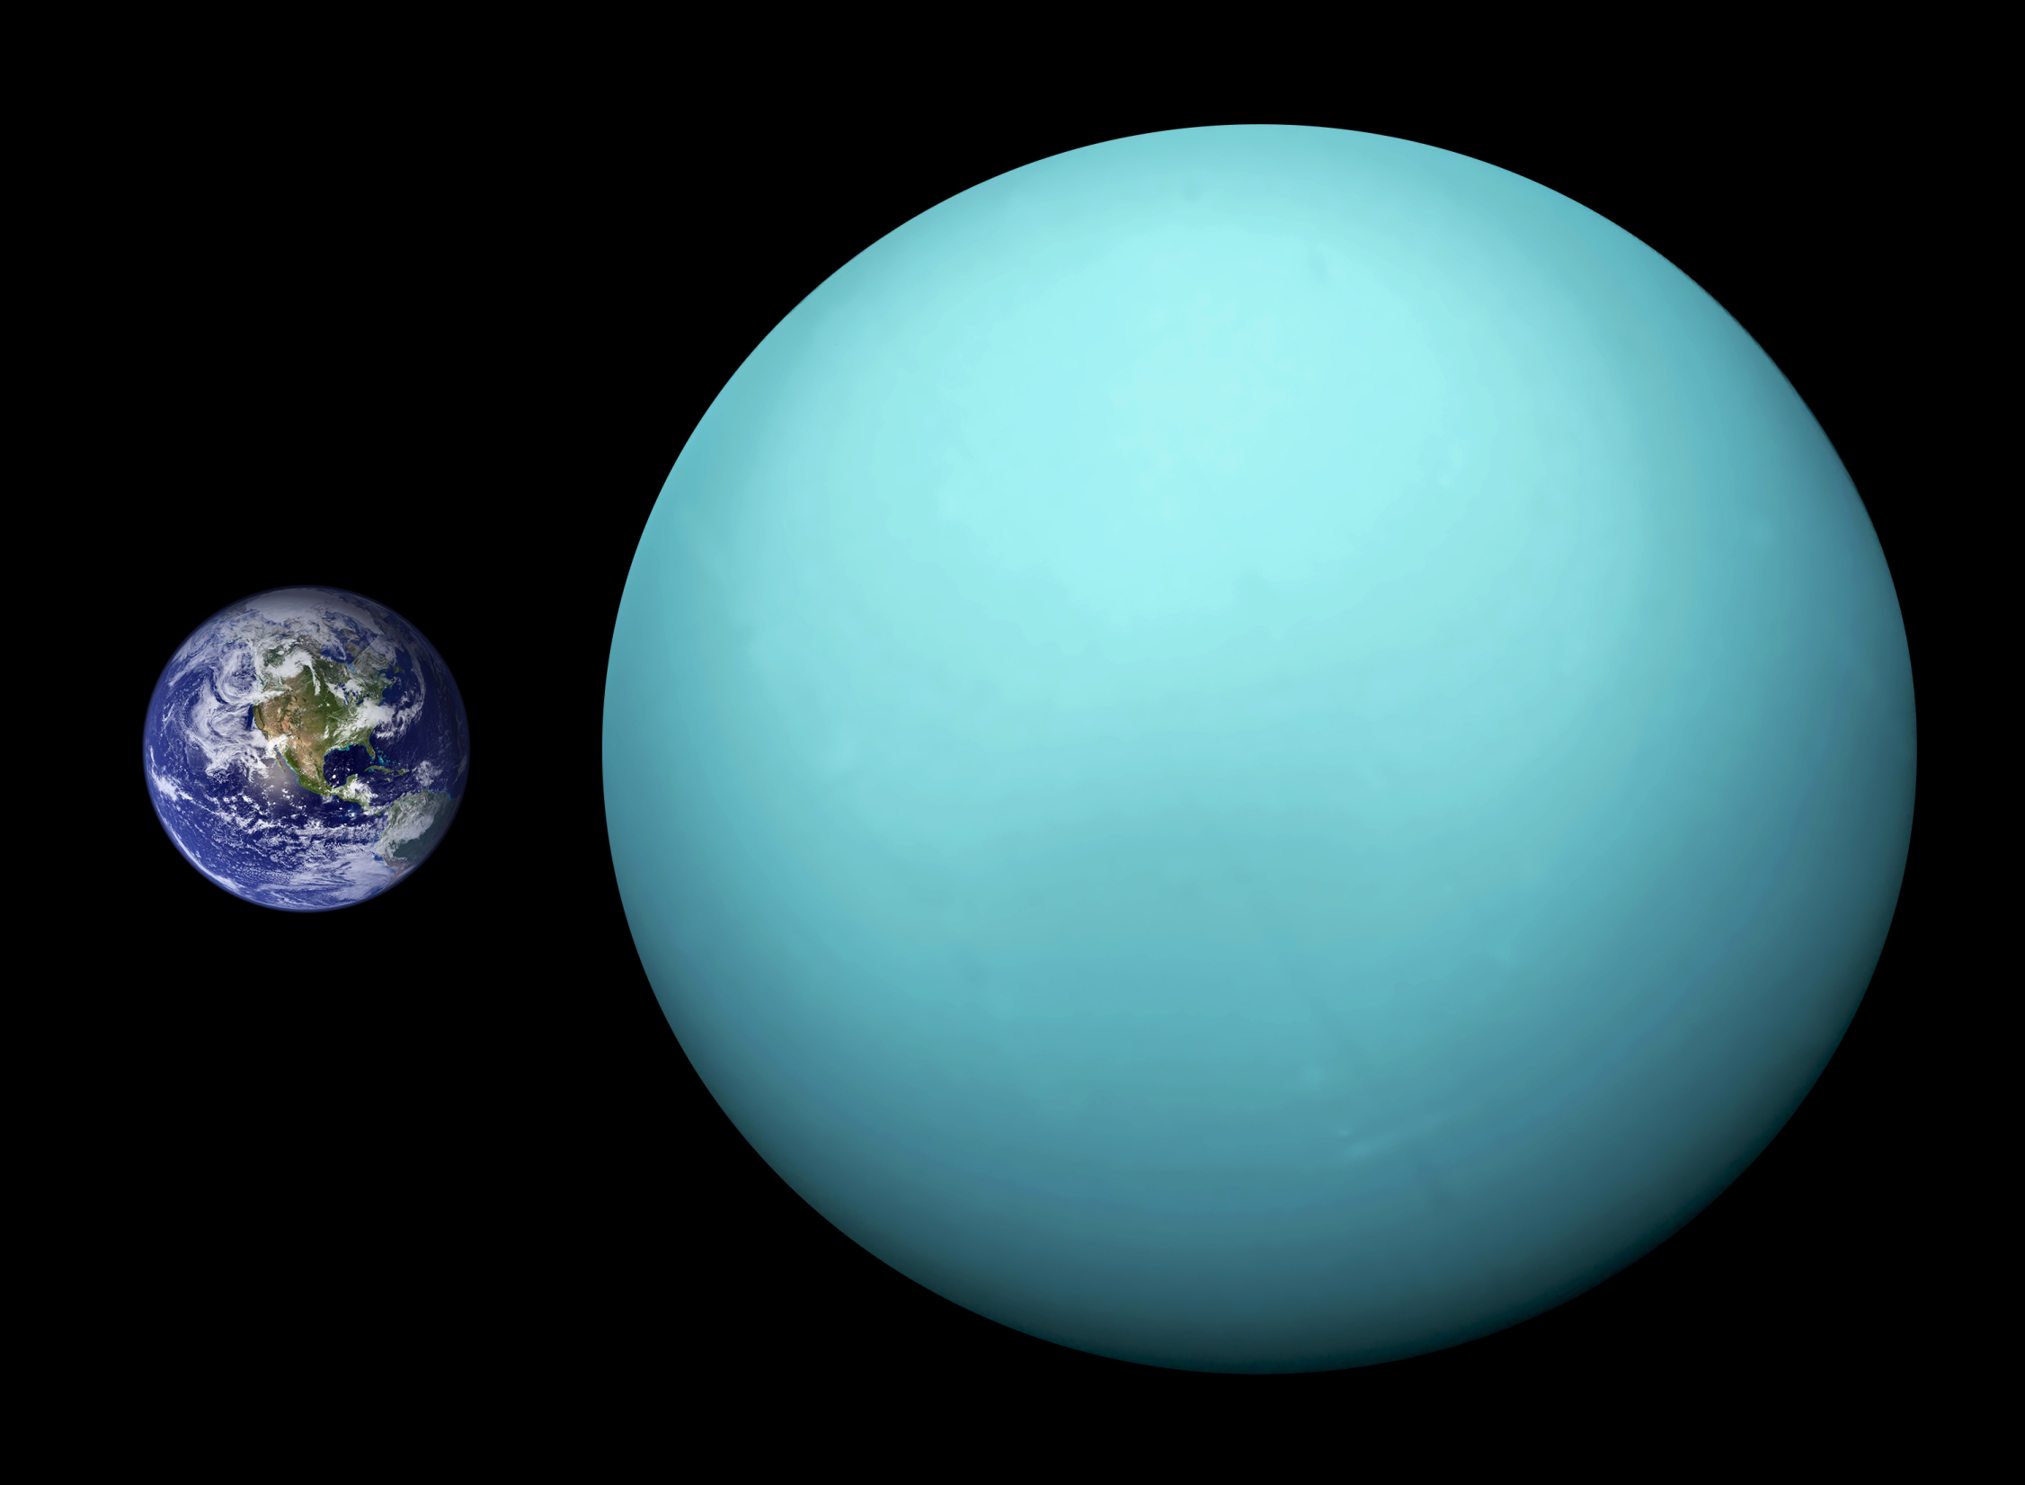
Uranus:
almost 32,000 miles
in diameter
4x larger than
Earth
mass is 14.5 times
Earth
2nd least dense planet
(Saturn is the least)
the 3rd largest planet (Jupiter & Saturn are bigger)

Slide 7
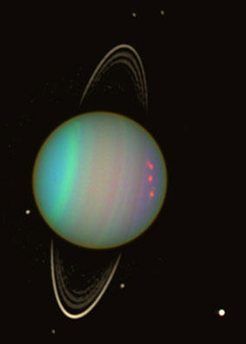
Uranus:
84 year orbit
1.8 billion miles from the Sun (Earth is 93 million miles from Sun)
1 day on Uranus is 17 hours
Uranus is coldest planet at – 372⁰ F

Slide 8
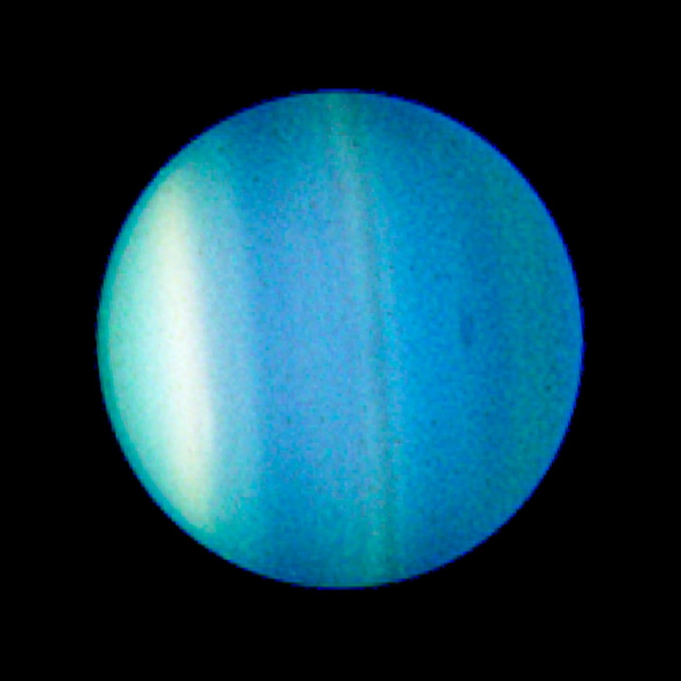
Uranus:
Atmosphere:
  83% hydrogen
  15% helium
  2% methane
Looks ice blue, cyan, turquoise, or aqua…but it is all because of the methane.
Strong winds cover the planet. Up to 560 mph winds blow opposite the direction that the planet spins at the equator. Near the poles, the wind blows in the opposite direction.

Slide 9
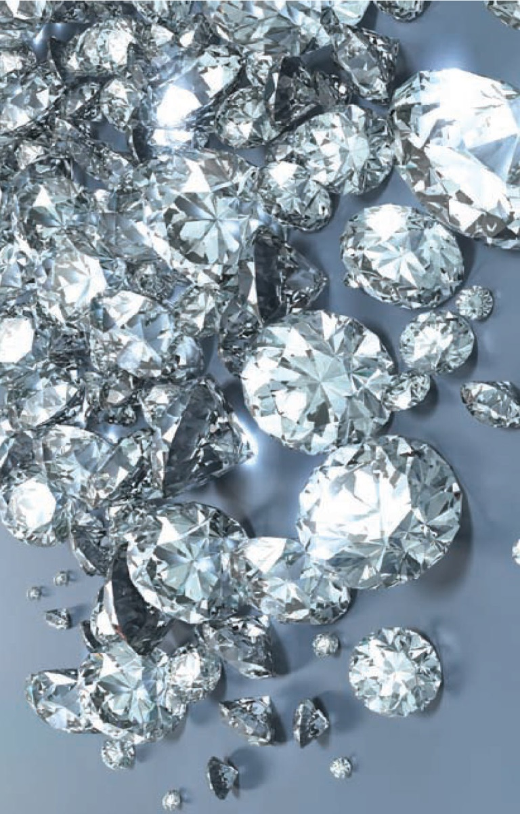
Uranus:
              Internal pressure is 8 million times sea-level Earth pressure
              Internal temperature is about
8500⁰ F
              Pressure & temperature can cause methane to break apart into hydrogen & carbon.
              Carbon at high pressure becomes diamonds and at higher pressure becomes liquefied.
Uranus (and Neptune) might have oceans of liquefied diamonds with diamond icebergs & diamond hailstones falling from the sky.

Slide 10
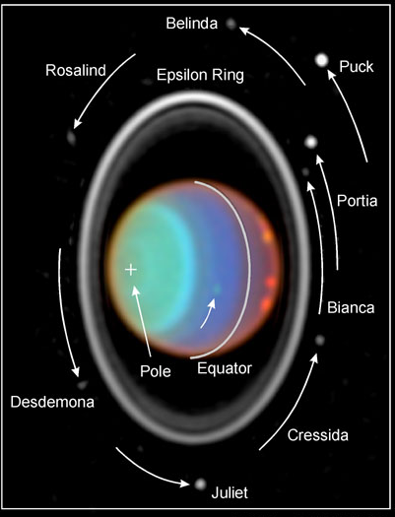
Uranus:
Rolls like a ball instead of spinning like a top like the other planets
Maybe Uranus got hit by an Earth-sized object, tipping it on its side
Each pole gets 42 years of light and 42 years of dark

Slide 11
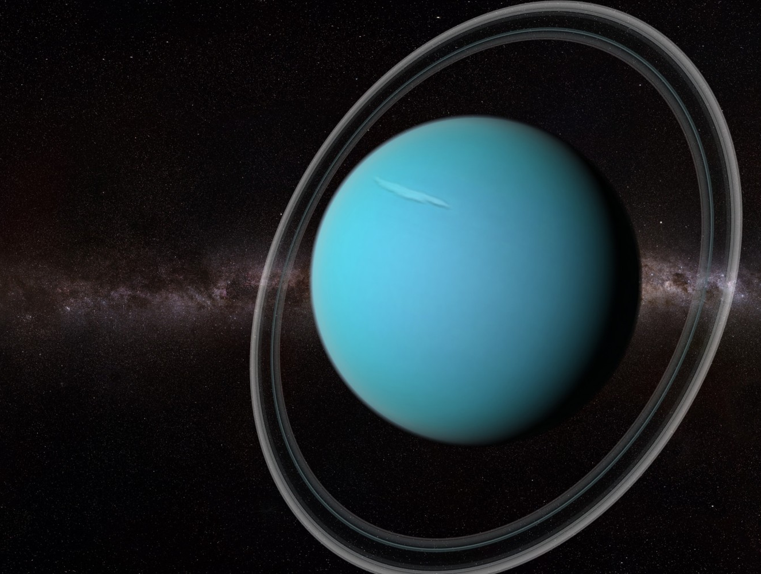
Rings of Uranus:
In 1977, 5 faint rings were discovered.
Voyager 2 discovered
13 rings circling
the planet
sideways, so
the rings are
vertical, not
horizontal.
Most of the rings are
small & dark,
but the outer ring shimmers blue like Uranus.
The blue color of this ring is likely from ice particles instead of methane however.

Slide 12
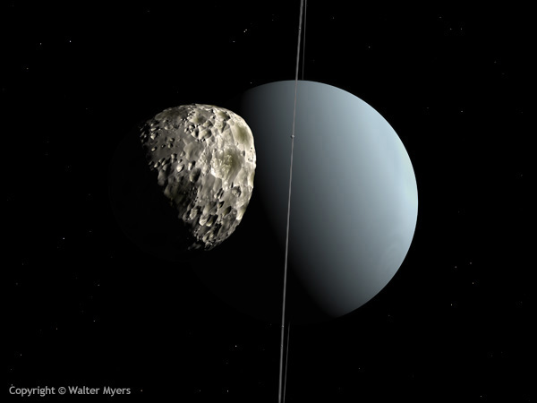
Moons of Uranus:
27 moons
Moon names are
taken from the
works of William
Shakespeare &
Alexander Pope,
and include names like Juliet,
Puck (pictured), Portia, Cupid,
Ariel, Umbriel, Titania & Oberon.
Most are fairly small…just hundreds of miles across.

Slide 13
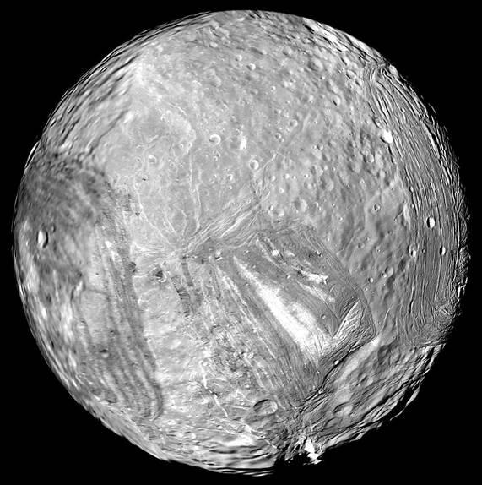
The moon of Miranda:
Miranda has lots of cracks.
It looks like it has been broken into pieces and clumsily put back together. This probably happened due to gravity of Uranus & other moons pulling it apart and back together again. It has likely shattered and reassembled at least 5 times.

